Slide 1
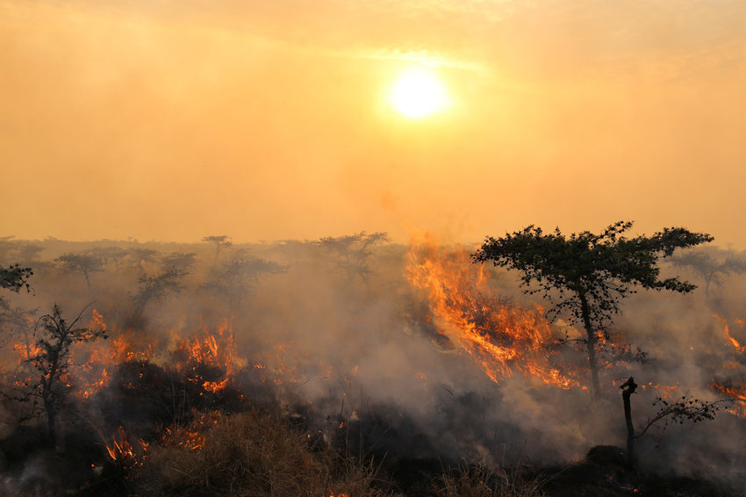
Vegetation Patterns in the Savanna and their susceptibility to wildfires
Bradley van Hooff, Mats Heine, Barber Vos, Leonardo Lüder

Slide 2
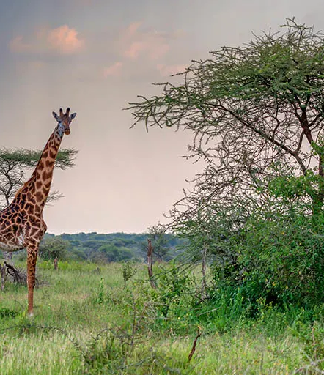
Structure
Savannas
Our Model
Results without fire
Adding wildfires
Results with fire
Problems and next steps

Slide 3
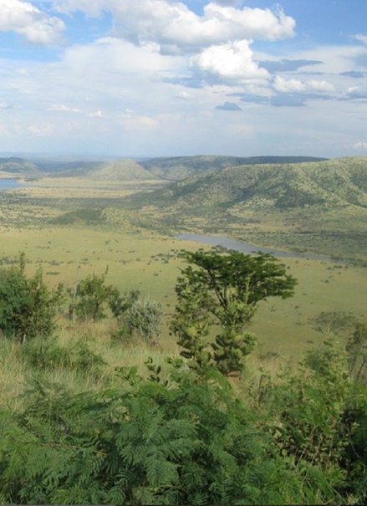
The savanna
The vegetation inlcudes mainly
Trees
Higher Biomass, slower spreading, less susceptible to fire
Grass
Faster spreading, very susceptible to fire
Formation of patterns

Slide 4
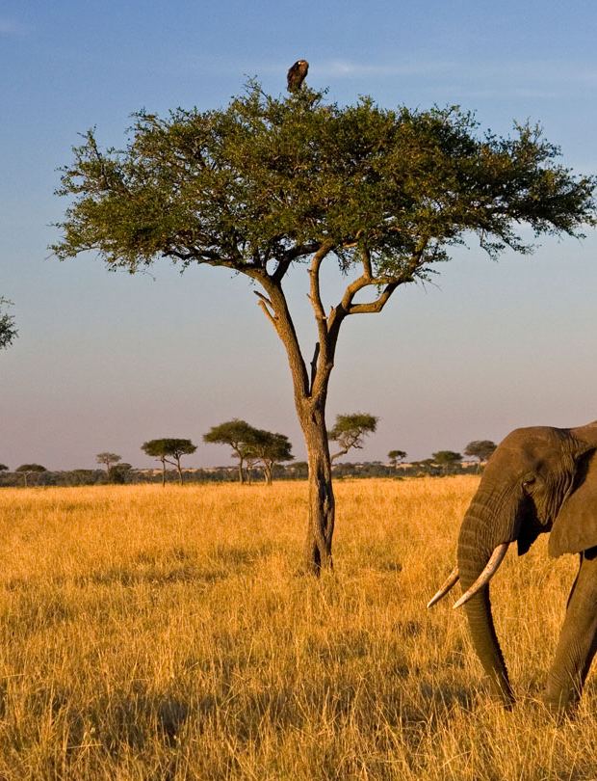
Our model
https://www.snexplores.org/wp-content/uploads/2021/12/1440_SS_savanna_feat.jpg

Slide 5
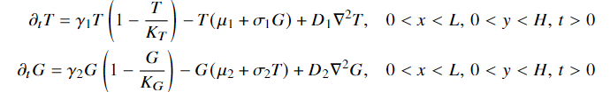
Dimensional Form
Growth
Mortality
Spreading
γ: Growth rates
K: upper bound for Biomass
μ: general mortality rate
σ: mortality trough competition
D: Diffusion coefficients

Slide 6
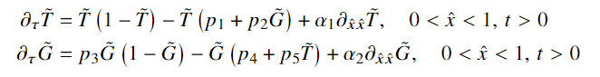
Dimensionless Form
Growth
Mortality
Spreading

Slide 7
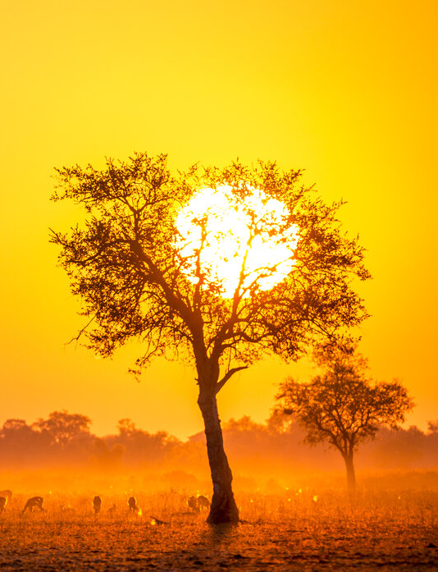
Results – no fire
https://www.snexplores.org/wp-content/uploads/2021/12/1440_SS_savanna_feat.jpg
https://images.photowall.com/products/65735/savannah-sunrise.jpg?h=699&q=85

Slide 8
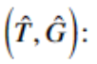
Analytical results – homogeneous equilibria
0
0
0
0

Slide 9
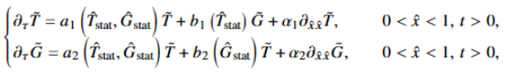
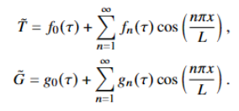
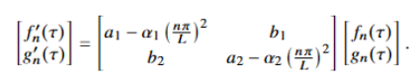
Analytical results – stability analysis
Linearization:
Eigenfunction expansion:

Slide 10
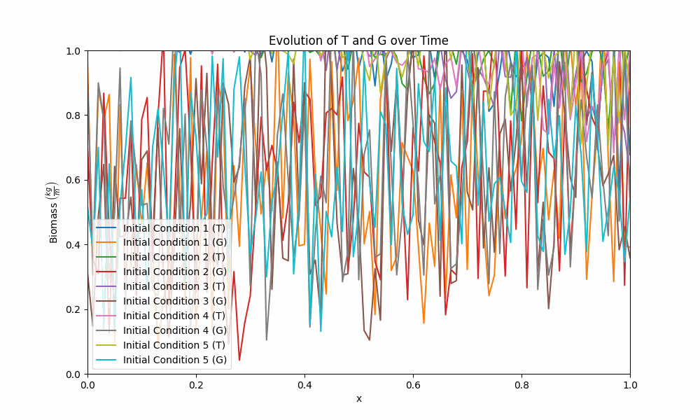
Numerical results – 1D
Time propegation:
Finite differences
Runga Kutta

Slide 11
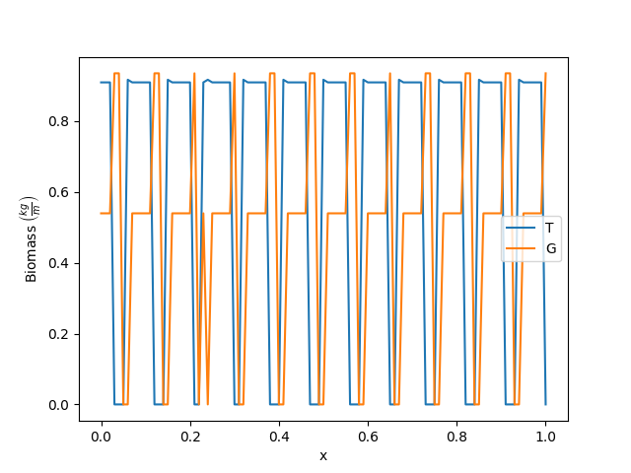
Numerical results – 1D
Root finding:
Finite differences
Newton Raphson

Slide 12
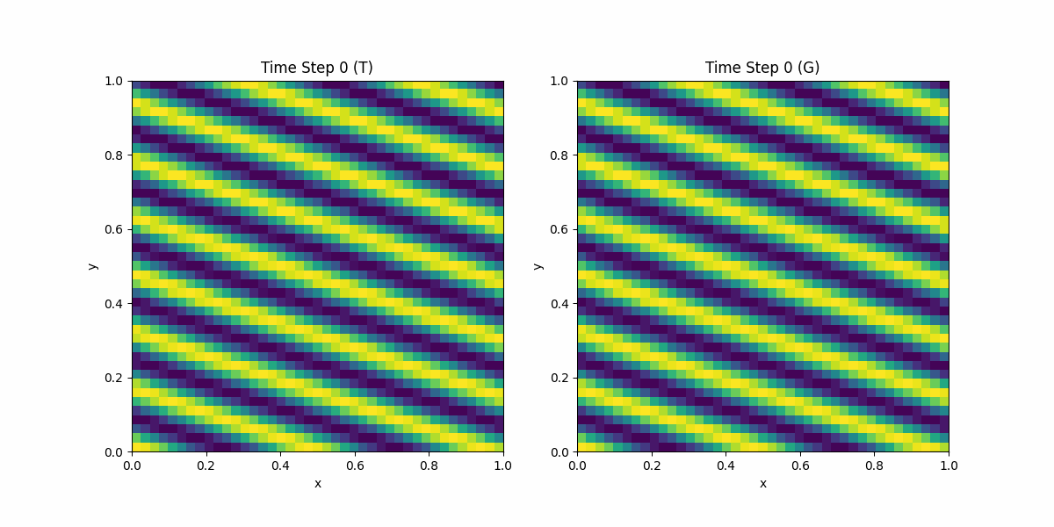
Numerical results – 2D

Slide 13
Fire
Burns the vegetation
In practice: only grass and young trees
Simplified model: no “insensitive” trees
“Pulse-like” phenomena
Simplest approach:
Let the vegetation reach an equilibrium point
Set the vegetation in an area to zero (G) and 0.5 (T)
Area dependent on fire intensity η
https://www.researchgate.net/publication/309019756/figure/fig6/AS:416409109712898@1476291076190/Photo5-Example-of-a-fire-in-an-African-savanna-Although-fixers-are-thought-to-have-a.png

Slide 14
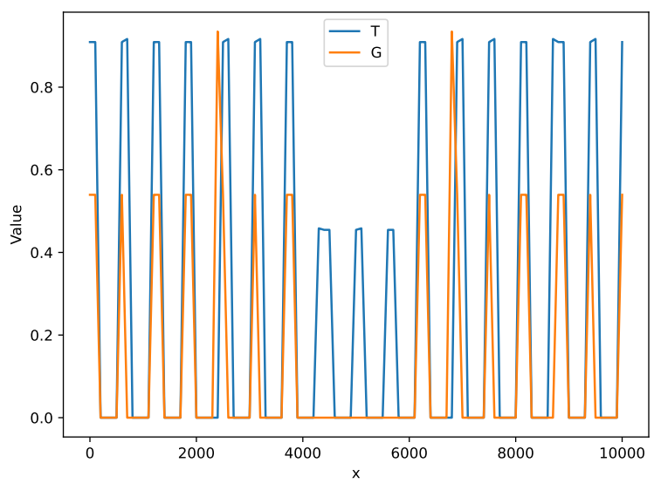
After the fire – new initial condition
1D:

Slide 15
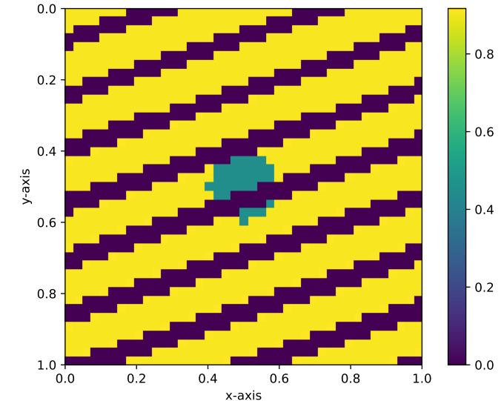
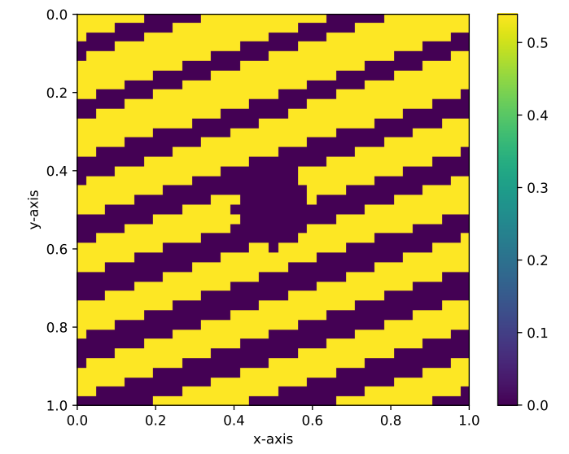
After the fire – new initial condition
2D
Trees
Grass

Slide 16
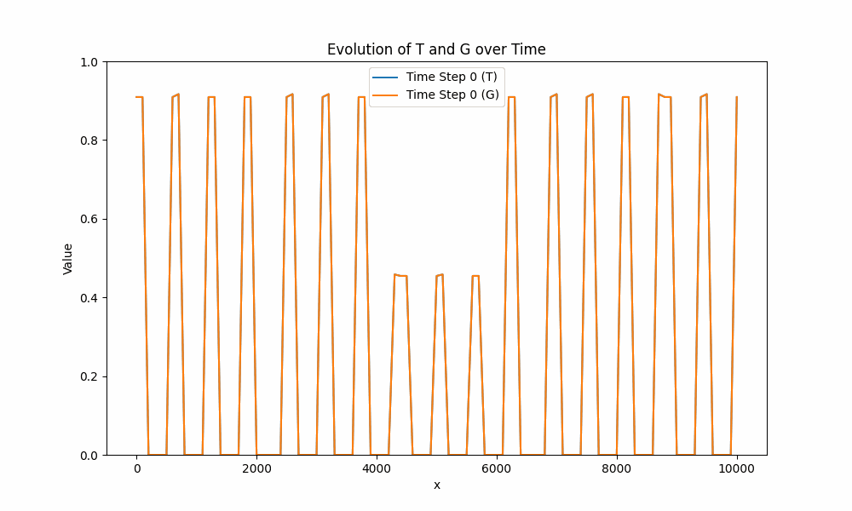
After the fire
1D:

Slide 17
After the fire
1D:

Slide 18
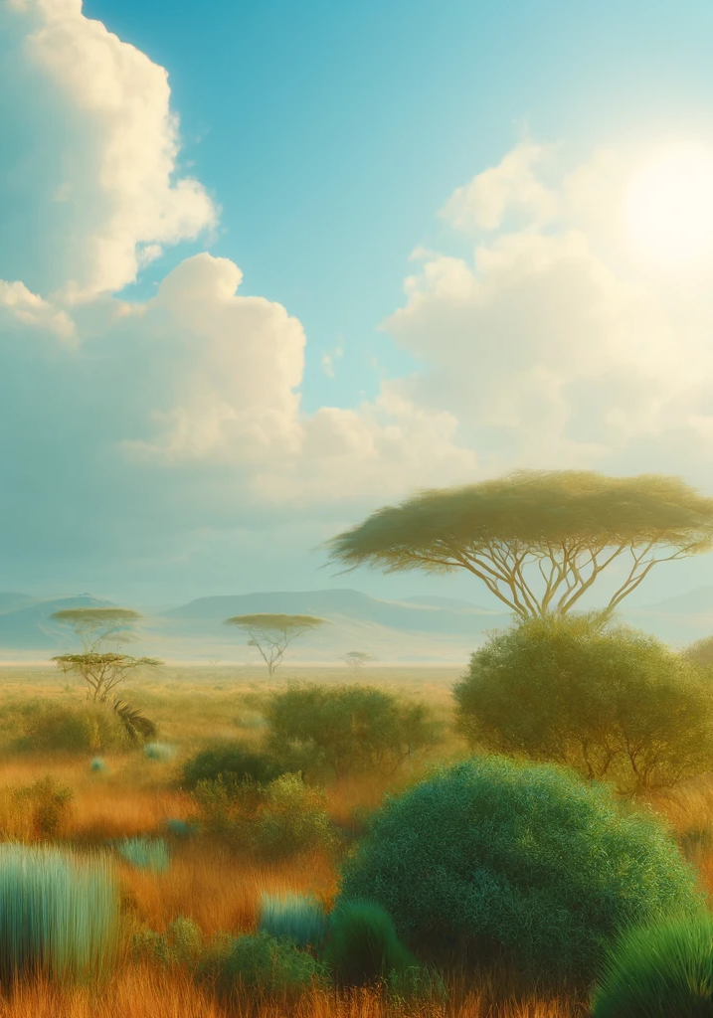
Problems and next steps
No stable patterns detected
Find parameters for which there is bistability
Investigate the effect of fire
Increase intensity
Find new equilibrium

Slide 19
Thank you

